Slide 1
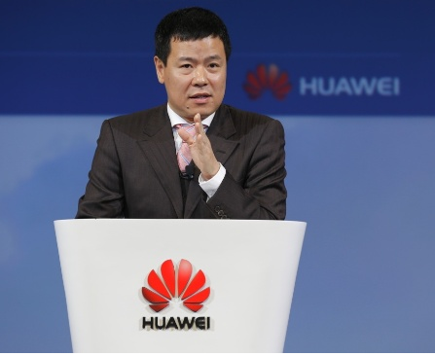
Liu Limin (Kenny)
President of the Financial Services Sector
Enterprise Business Group
Huawei Technologies Co., Ltd.
Liu Limin joined Huawei in June 2014 and is now leading the organization of global sales activities in the financial services industry. He has been working in the ICT industry for more than 20 years since his graduation from Zhejiang University. He once served global leading technology companies for a number of years, taking multiple sales executives positions. Liu is especially experienced in serving customers in the financial services industry.

