Slide 1
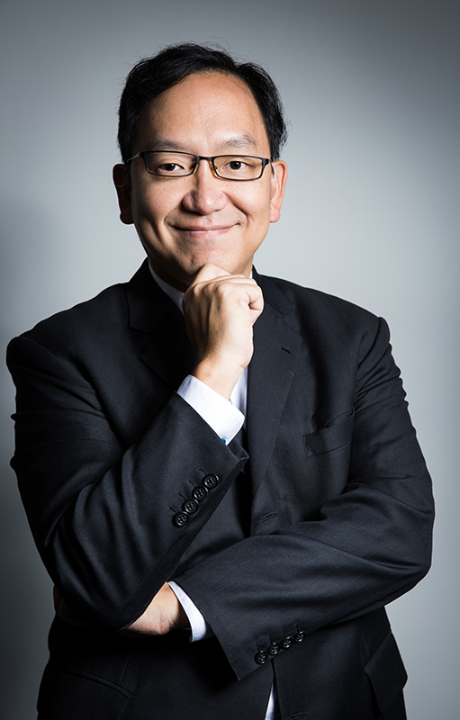
Jackal Ma
Co-Founded Tongdun Technology(Former know as Fraudmetrix), Pioneer in Applicaton of Big Data technology into daily business with his “Cross Industry Joint Defense” concept.
Born in Hong Kong, with a Bachelor degree in Electrical and Electronic Engineering from University of Hong Kong, and an Executive MBA degree from China’s Top Business School Chang Kong Graduate School of Business.
30 years working experience covering North America, Australia, Asia and Europe. Seasoned technology and business executive in Asia, with previous experience including:-
Senior Engineer at IBM China/Hong/Canada
Head of Technology Planning at Royal Bank of Canada
Chief Architect of Hong Kong Octapus Card System
Asia Regional Head of Operation at AXA insurance
President at EDIFY Asia, JV between US and China
Managing Director at Aspect Software for North Asia
Advisor and consultant at various business/technology transformation initiatives such as Citibank/HSBC/Standard Chartered/PingAn Insurance/China Construction Bank/ Pudong Development Bank
Appointed as Advisory consultant for various Country level initiatives in China including Ministry of Industry and Information Technology, National Development and Reform Committee
VP of Asia Pacific of ThreatMetrix
Startup Tongdun Technology as Co-founder and Executive VP/Chief Strategy Officer, the world’s fastest growing Big Data Fintech Company in 2015 and 2016

